Slide 1
ENSE 470 - Milestone 2
Timbits
Maksym Zabutnyy, Earl Macalino, Jennifer Herasymuik
January 25th, 2018

Slide 2
Kaizen Bursts
Multiple ways to get permission from authorizer which can cause unnecessary transportation and movement.
Multiple ways to send request which can cause unnecessary transportation and movement.
Inventory mismanagement causes analysts to search two different documents for request validation.
Analyst assigns wrong permissions which is a defect that blocks proper interaction.
Sometimes customer needs to re-submit request which causes overprocessing.
Notes:
Earl

Slide 3
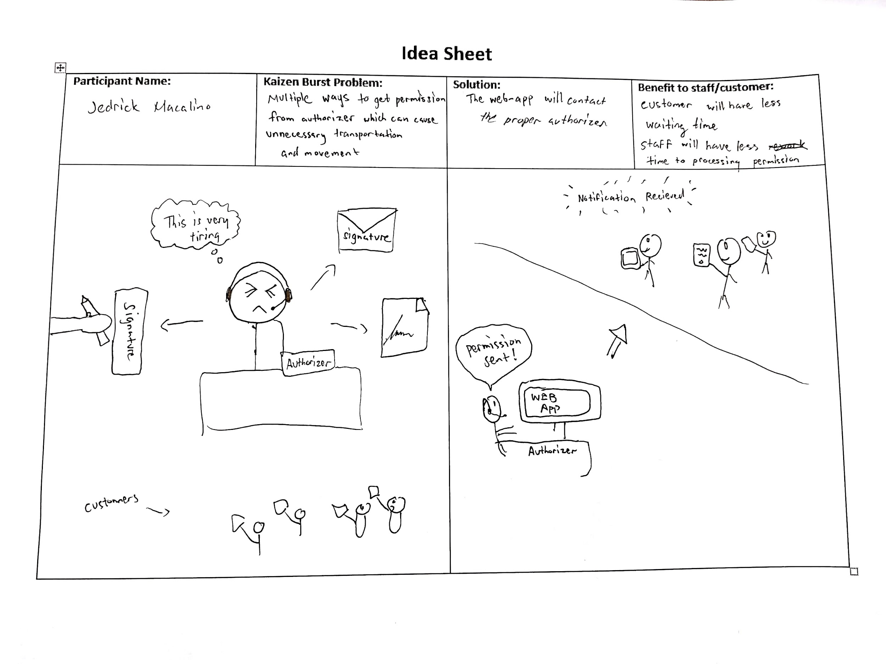
Idea Sheet - Authorization
Notes:
Earl

Slide 4
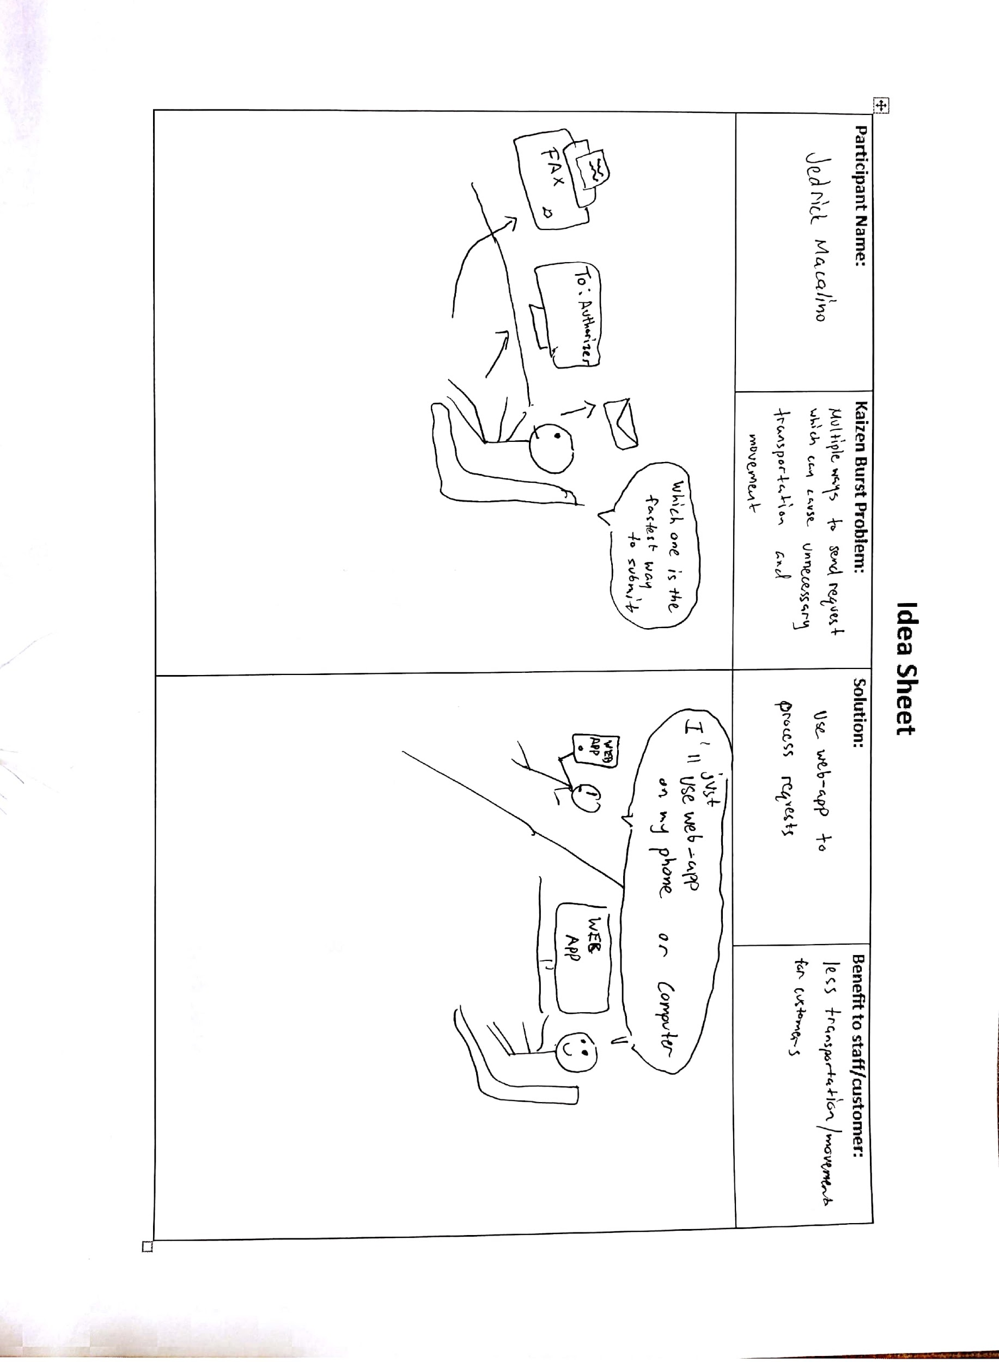
Idea Sheet - Sending Request
Notes:
Earl

Slide 5
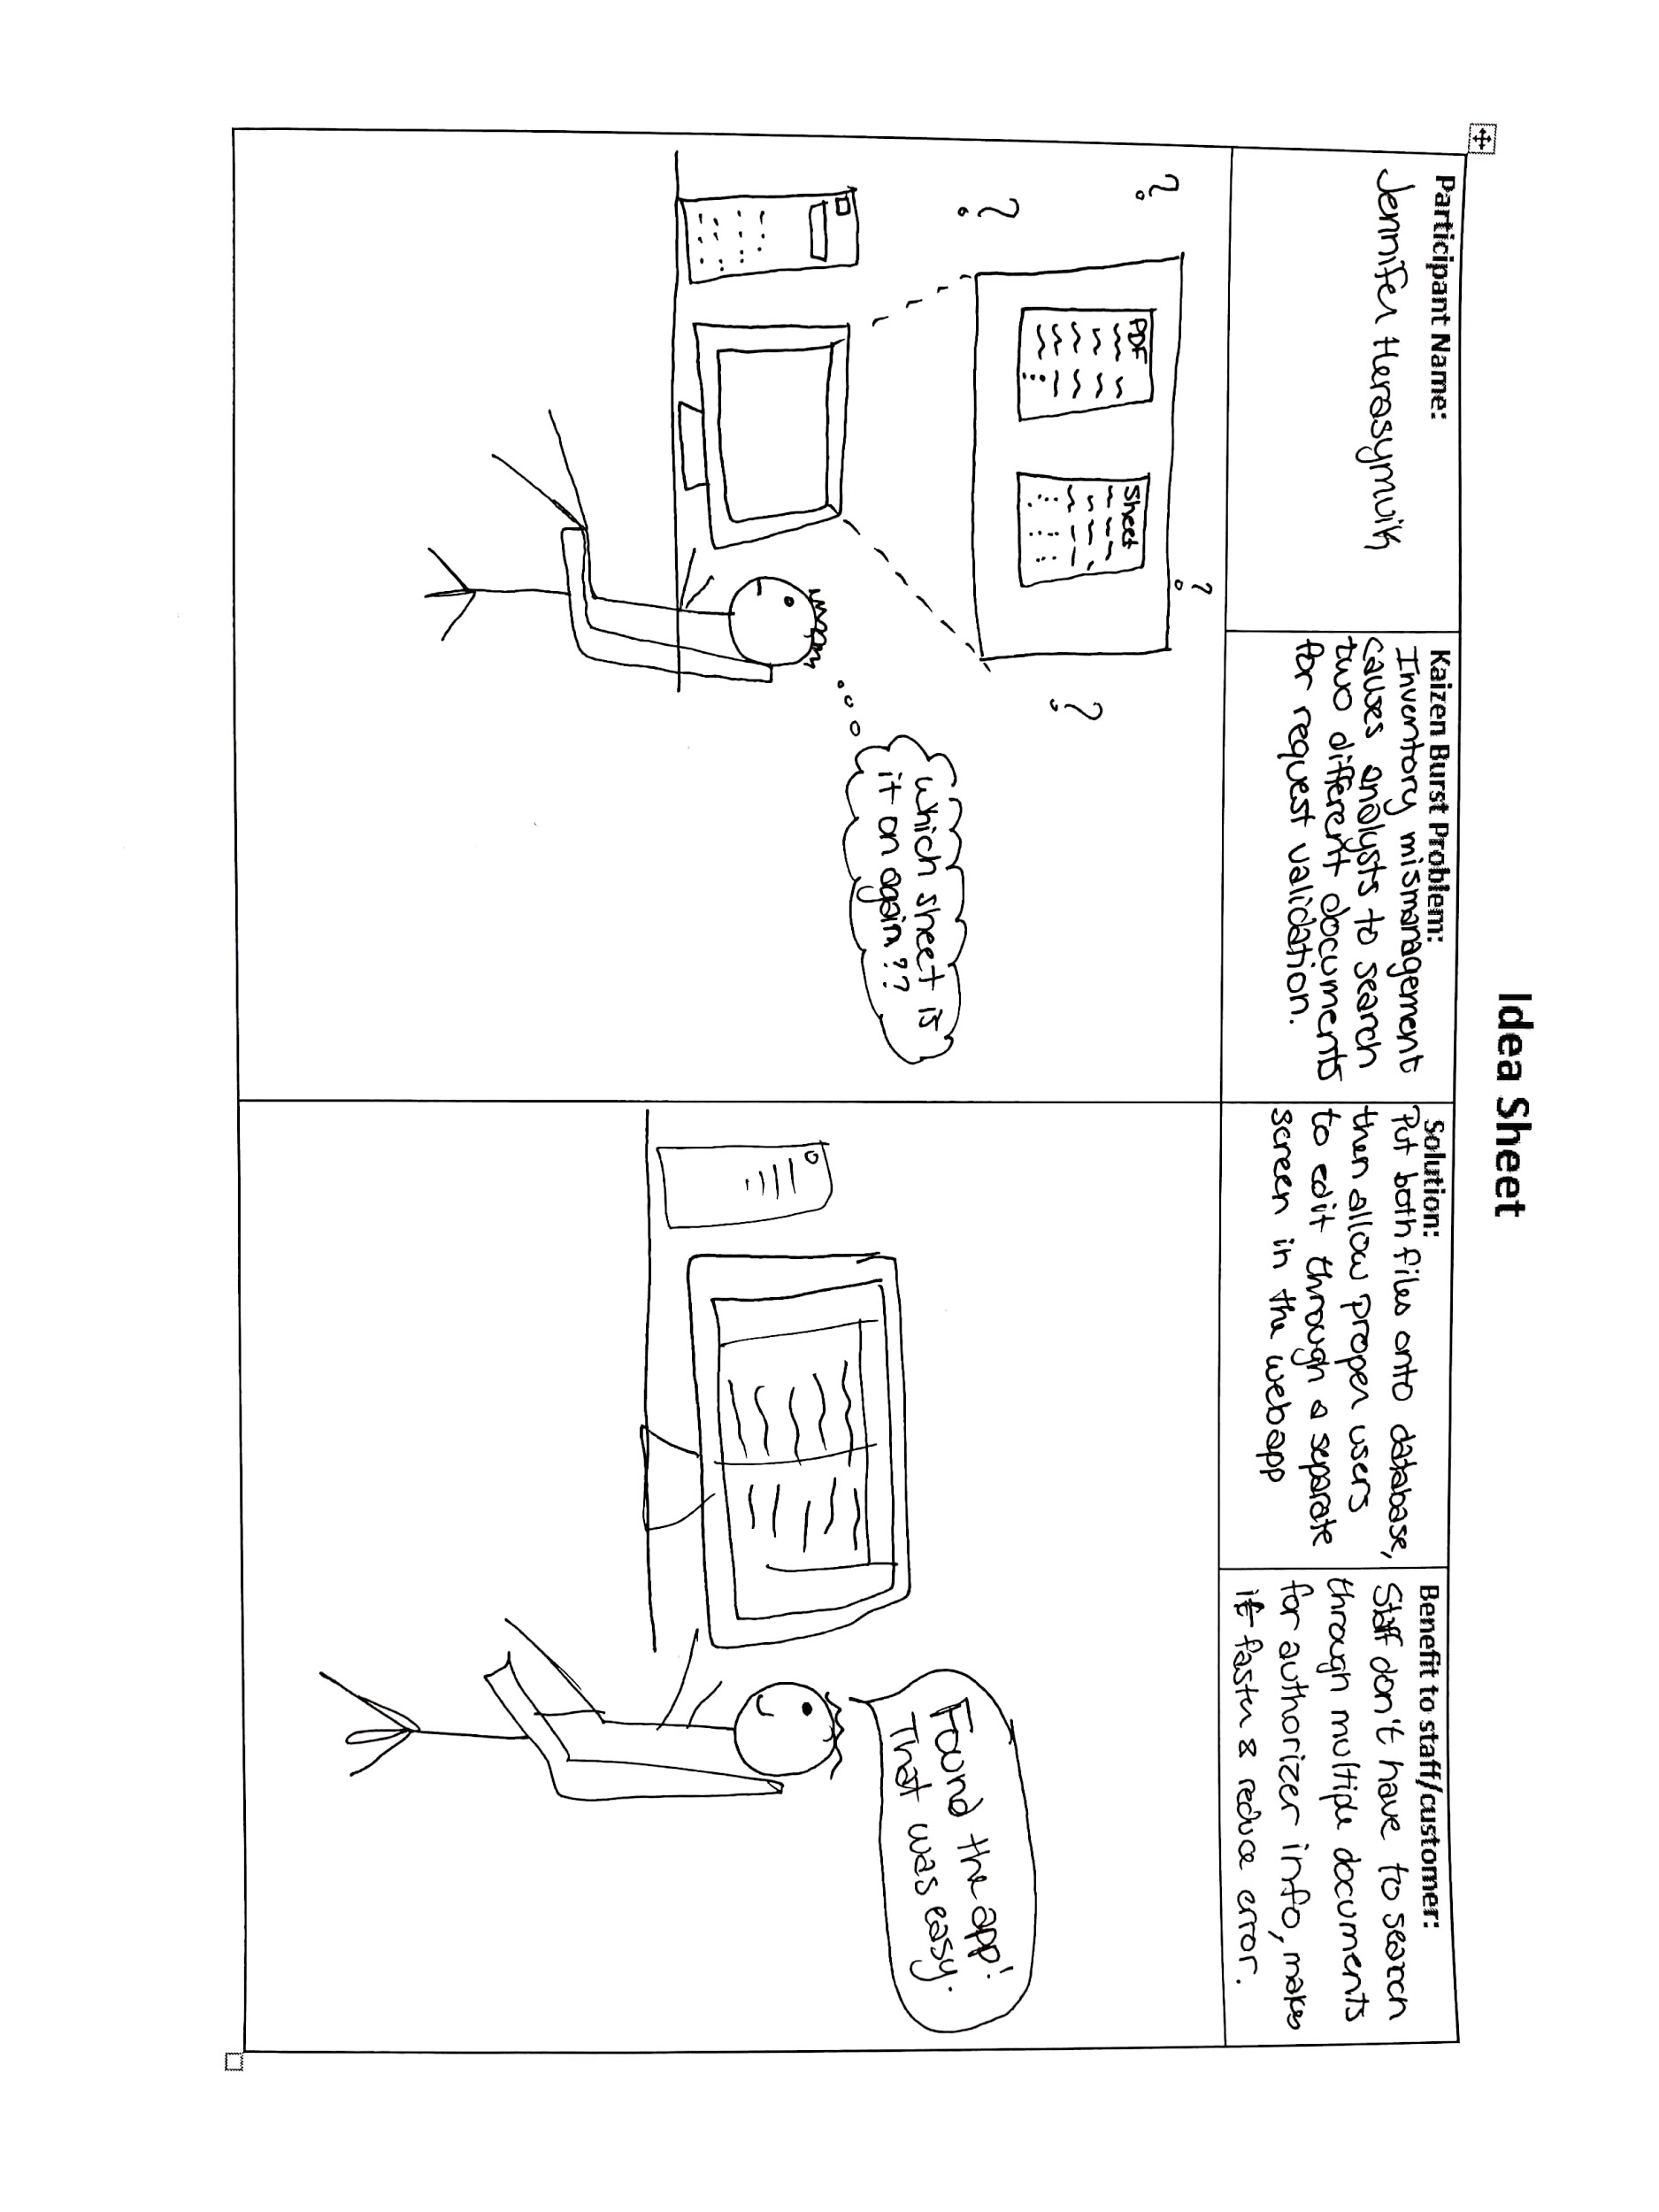
Idea Sheet - Validation Documents
Notes:
Jenn

Slide 6
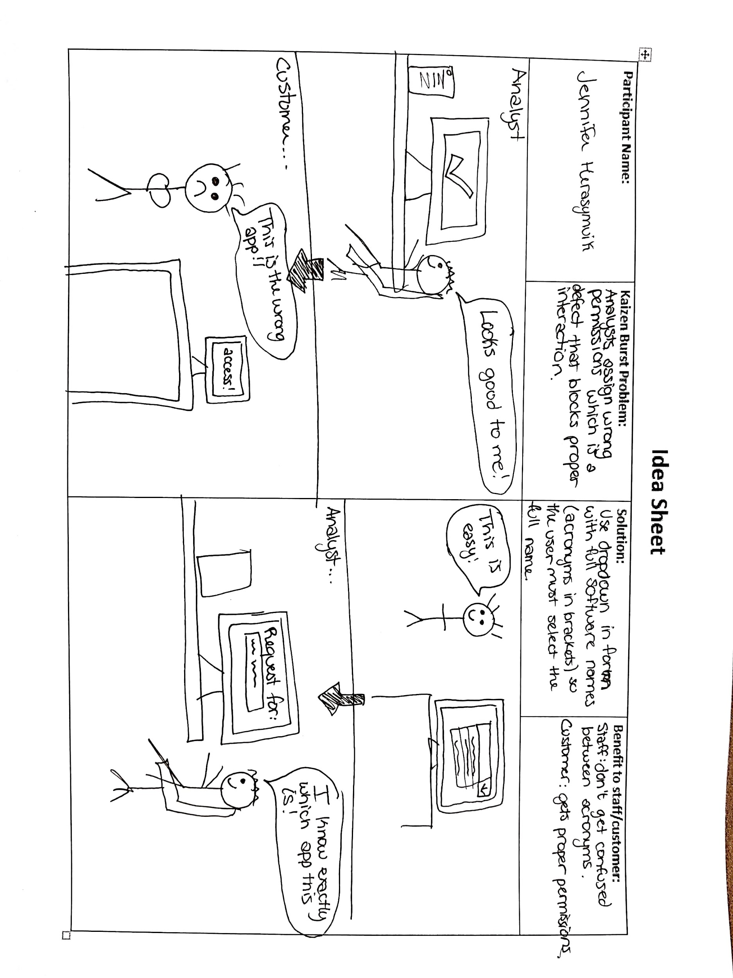
Idea Sheet - Wrong Permissions
Notes:
Jenn

Slide 7
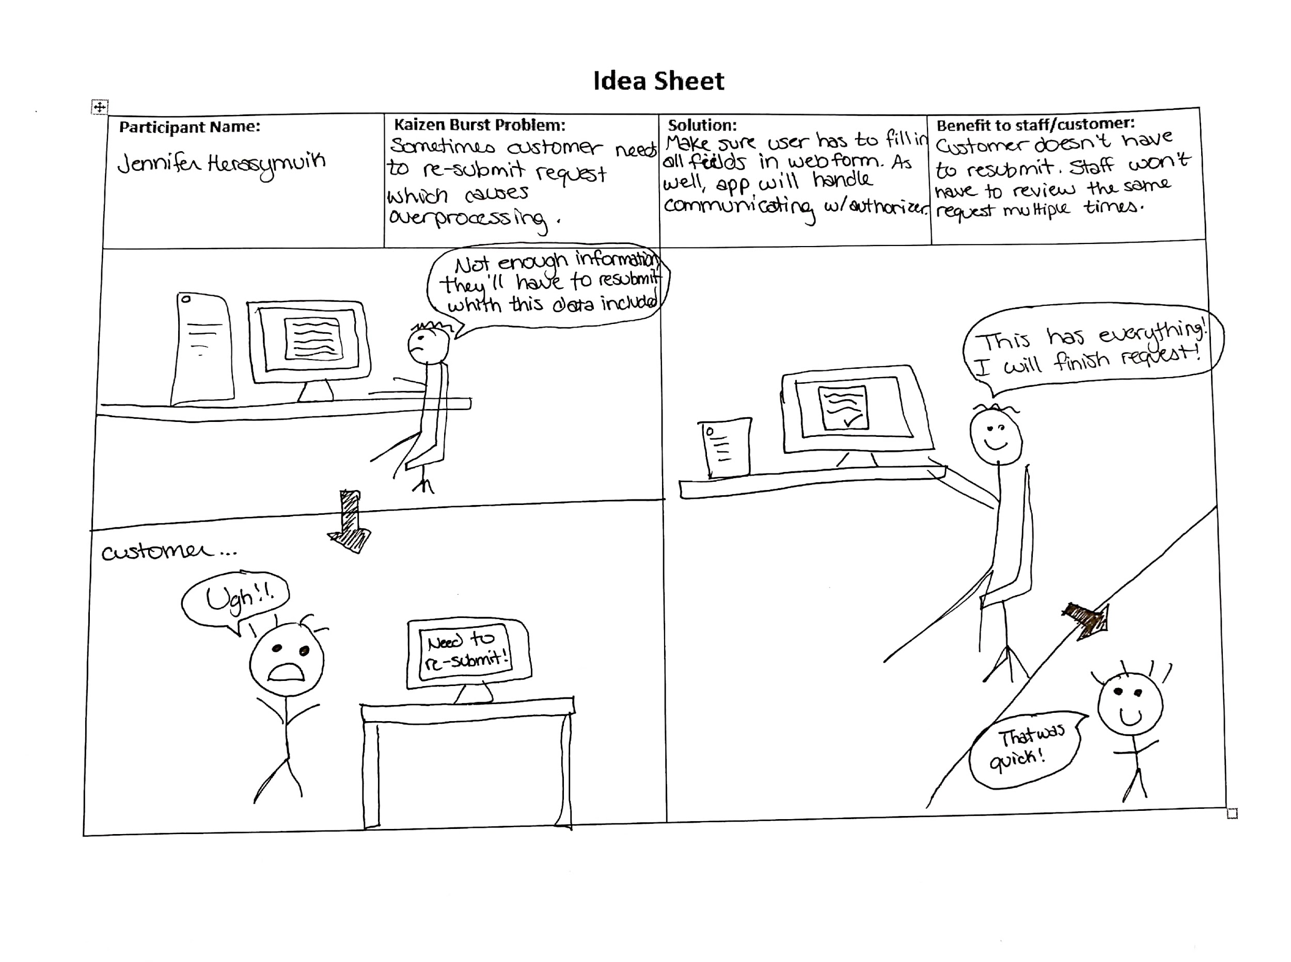
Idea Sheet - Re-submit
Notes:
Jenn

Slide 8
Idea Sheets
Authorization and Request Idea Sheets - Web app only
Both reduce movement and transportation because we are solely using the web app to handle everything from now on.
Validation Documents - Use of Database
Uses database instead of two documents
Wrong Permissions and Re-submit - Use of Web Form
Since were using form, both of these issues are solved by using a drop-down and forcing the user to fill out all requirements.
Notes:
Jenn

Slide 9
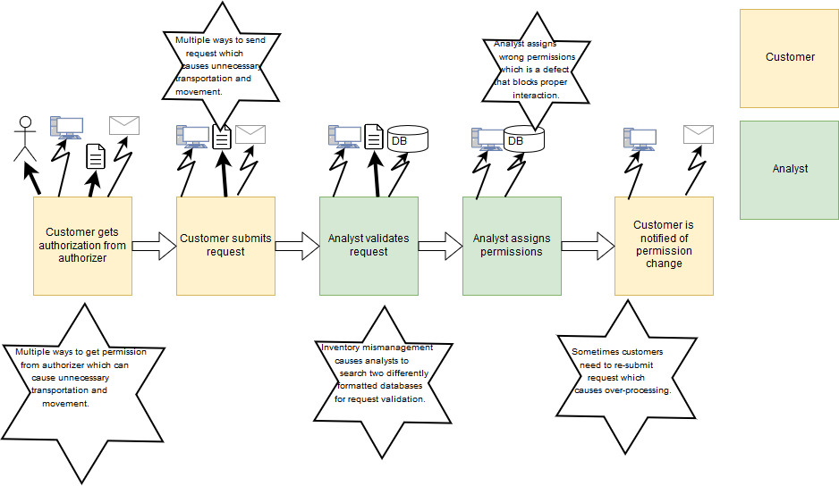
Current State VSM
Notes:
Jenn

Slide 10
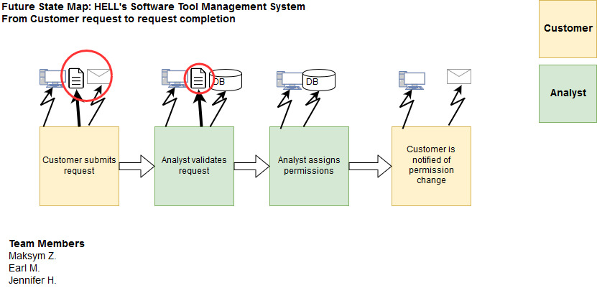
Future State VSM
Notes:
Jenn & Earl

Slide 11
Improvements from Current VSM
Removed step where customer needs to contact authorizer.
Saves time since app will handle this instead. No need for customer to have excessive movement or transportation.
For requests, it's only through a web app (no email or forms to fax).
Easier for customer and for the analyst (again movement and transportation reduced)
When analyst validates, they only have to look at a webform not paper documents.
All data is in one spot now and can be edited through web app. No extra inventory to manage since it’s all on database instead.
Web App automatically send out email so analyst doesn't have to.
Customer doesn’t have to wait for analyst email.
Notes:
Earl - Main points
Jenn - Sub points

Slide 12
Reflection
How did you feel about this milestone? What did you like about it? What did you dislike?
Feels the same as first, I liked it helps find wastes, I disliked that we need to keep it under 5 min
What did you learn about yourself as you collaborated and worked through this milestone?
Experiencing Involvement in a workforce since vsm is used in offices too
How will you use what you have learned going forward?
Use idea sheets in future projects to visualize what we are trying to solve.
Analysis between the current and future state to see what we are improving and if it’s actually an improvement.
What “stuff & things” related to this milestone would you want help with?
Sorting the idea sheets, not sure how to go about this.
Notes:
1.
2. Its a group exercise

Slide 13
Questions?

